Slide 1
Project Weekly Deliverable
Schematic Diagram Development using Software Tools
Francis Vijith A J – Team 1
C0742980

Slide 2
CONTENTS
EasyEDA: Schematic design Platform
PIC16f877a Microcontroller : A general layout
Interfacing PIC16F877a & LCD display
Interfacing PIC16F877a & ESP2866
Interfacing PIC16F877a & stepper motor
Interfacing PIC16F877a & Ultrasonic Sensor
Power supply & oscillator
Final Circuit
REFERENCES

Slide 3

EasyEDA: Schematic design Platform
EasyEDA is an online Electronic Circuit design tool intended for to make circuit designing easy and fast.
It provides several schematic development tools, through various user contributions.
EasyEDA is mainly used for the schematic circuit development in this project.

Slide 4
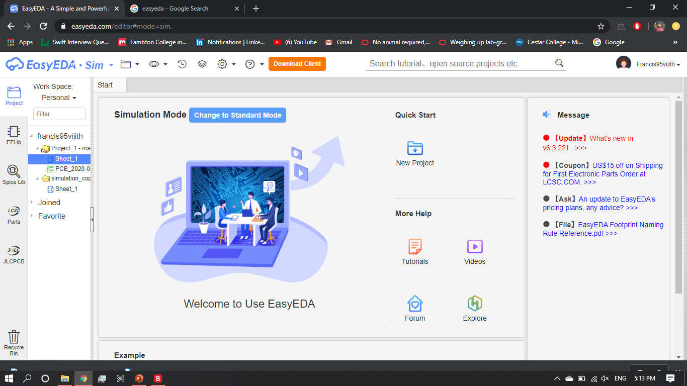
EasyEDA: Schematic design Platform(contd.)

Slide 5
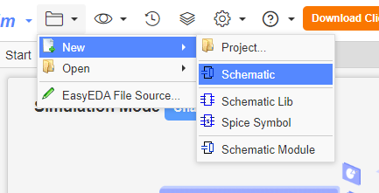
EasyEDA: Schematic design Platform(contd.)

Slide 6
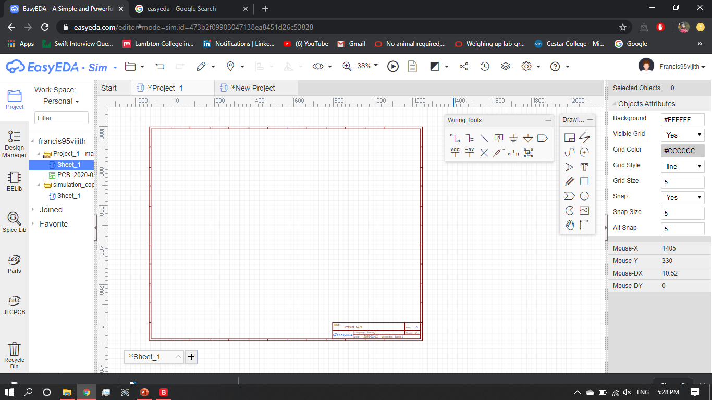
EasyEDA: Schematic design Platform(contd.)

Slide 7
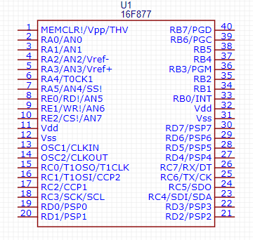
PIC16f877a Microcontroller : A general layout
Flash program memory – 4 KB
Interrupts – 14
I/O ports – A,B,C, D & E
Serial communication – MSSP, UART
40 pin PDIP

Slide 8
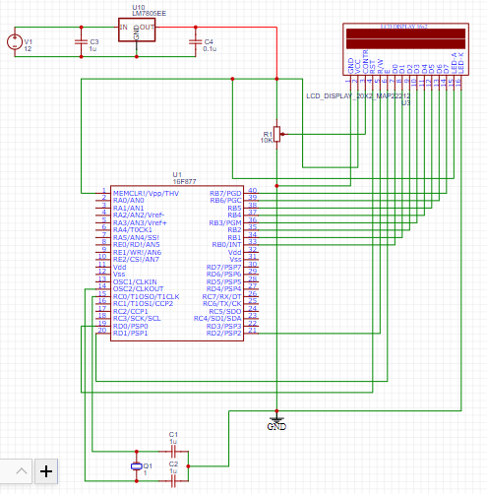
Interfacing PIC16F877a & LCD display
PORT B is used to transfer the bits from PIC(33-40) to LCD(7-14)
RD0(pic19) – RST(LCD4)
RD1(pic20) – E(LCD6)
RD2(pic21) – R/W(LCD5)
Vpp(pic1) – VCC(LCD2)
GND – GND
Vcc - LED-A
GND – LED-K

Slide 9
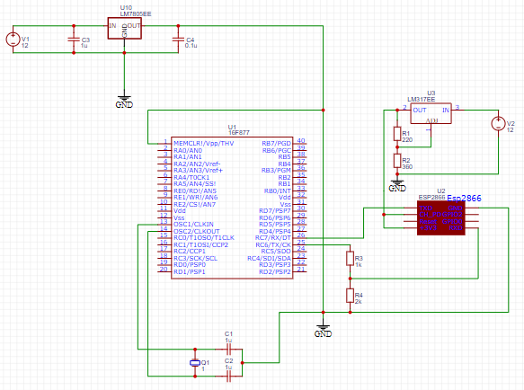
Interfacing PIC16F877a & ESP2866
RX(PIC26) – TXD(ESP)
TX(PIC25) – RXD(ESP)
An LM317 voltage regulator is used to provide 3.3V to ESP.
A voltage divider circuit is used between the TX(PIC) and RXD(ESP) to change the voltage level from 5V to 3.3V.

Slide 10
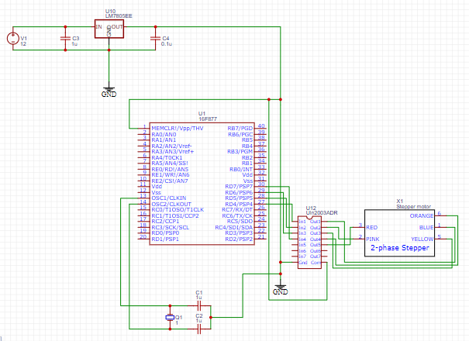
Interfacing PIC16F877a & stepper motor
ULN2003 on board chip module is used to drive the stepper motor
RD7(PIC30) – IN1(ULN)
RD6(PIC29) – IN2(ULN)
RD5(PIC28) – IN3(ULN)
RD4(PIC27) – IN4(ULN)
OUT1(ULN) – BLUE(1SM)
OUT2(ULN) – PINK(2SM)
OUT3(ULN) – YELLOW(5SM)
OUT4(ULN) – ORANGE(5SM)
OUT5(ULN) – RED(3SM)

Slide 11
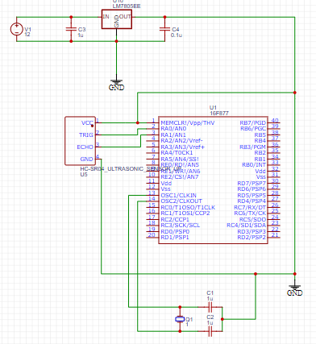
Interfacing PIC16F877a & Ultrasonic Sensor
PORT A is used to trigger pulse signal and receive the data from all the sensors.
Five sensors are used to create a sound environment of range.

Slide 12
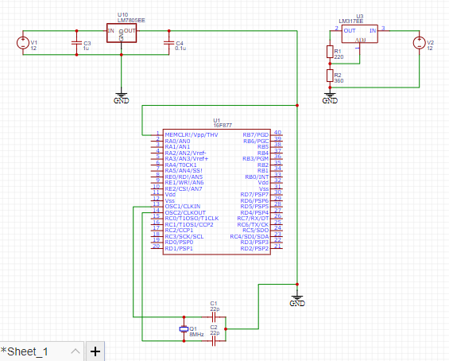
Power supply & oscillator
A single 12V adapter is intended to use as power supply
LM7805 is used to regulate the voltage supply from 12V to 5V for PIC.
LM317 is used for the ESP2866 to supply 3.3V.
HS (high speed or high gain) mode is opted for crystal oscillations.
Two 22pF capacitors are used to for an 8MHz operation in the HS mode.

Slide 13
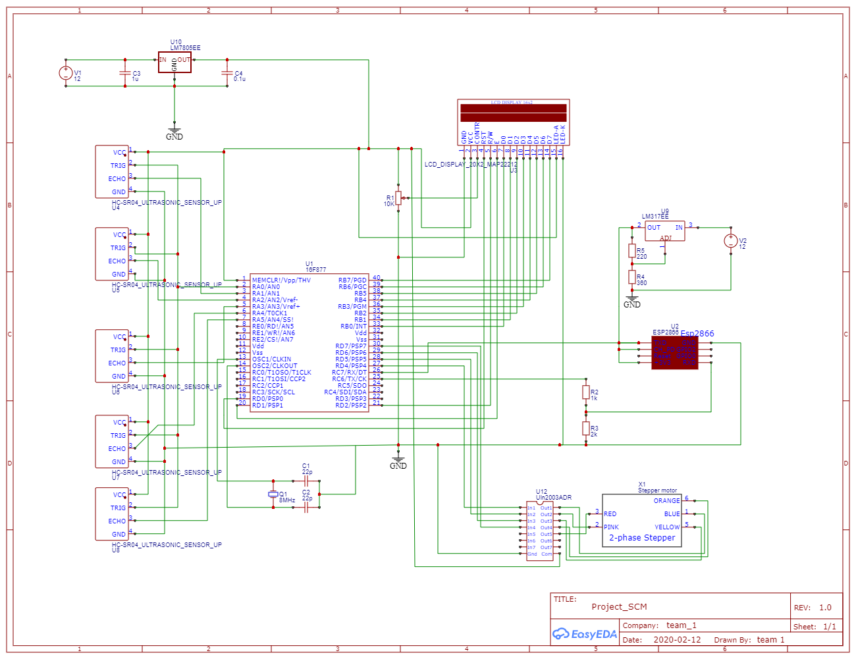
Final Circuit

Slide 14
REFERENCES
https://easyeda.com/editor#mode=sim,id=473b2f09903047138ea8451d26c53828|!91f1d6d4d3c84396bec512da240f40c4|!aa61e6cddfea46cdad04dfa7885f82bd
https://circuitdigest.com/
http://www.t-es-t.hu/download/microchip/an849a.pdf

